Slide 1


Slide 2

Course Code: EECE- 434
Course Name: Microwave Engineering Laboratory
Group No: 04

Slide 3
PROJECT
Yagi-Uda Antenna Using CST Studio Suite

Slide 4
GROUP MEMBERS
Name | Student ID
Mayan Uddin Sizan | 202016069
Mansib Hasan | 202116037
Md. Farhan Fuad | 202116046
Md. Mostaque Mahbub Tamim | 202116050
Nasif Ahmed Rafe | 202116072

Slide 5
CONTRIBUTION
Student ID | Antenna Design | Parameters Adjustment | Result Analysis | Report Writing | Presentation Slides
202016069 |  | ✓ | ✓ |  | ✓
202116037 | ✓ | ✓ |  | ✓
202116046 | ✓ |  | ✓ | ✓
202116050 | ✓ |  | ✓ | ✓
202116072 | ✓ | ✓ |  | ✓

Slide 6
Introduction
Problem Statement and Design Criteria
Literature Review
Methodology
SCOPE
Simulation Results
Interpretation of Results
Application of the Design
Shortcoming/Drawbacks of the Design
Conclusion
References

Slide 7
Introduction
The Yagi-Uda antenna, known for its directionality and high gain, is a staple in wireless communication. Its unique design, featuring a driven element, reflector, and multiple directors, allows it to focus energy in a specific direction, enhancing signal reception and transmission over long distances. This antenna's adaptability and efficiency have cemented its place as a preferred choice in various applications, from amateur radio to space communication systems.

Slide 8
Problem Statement and Design Criteria
Design, simulate and analyze Yagi-Uda antennas with 3 and 8 elements uing CST Suite. The objective is to evaluate the impact of the number of elements on key antenna parameters such as S parameter, VSWR, gain, and far-field polar diagram. The aim is to enhance antenna performance for efficient directional communication systems.

Slide 9
Problem Statement and Design Criteria
Design criteria are as follows:
Frequency range
Element configuration
Simulation parameters
Performance metrics
Optimization

Slide 10
Literature Review
This review covers Yagi-Uda antenna design, performance factors like director number and spacing, and CST-based optimization trends. Invented by Uda and Yagi, the antenna’s gain increases with more directors, though larger designs may be impractical for compact devices . A Yagi-Uda antenna has a dipole-driven element, and parasitic reflectors and directors, which passively shape the radiation pattern. Varying director lengths improves gain and impedance matching across frequencies .

Slide 11
Design parameters
Element | 3 element Yagi-Uda antenna | 8 element Yagi-Uda antenna
Operating frequency | 2.45 GHz | 2.45 GHz
Wavelength | 113.2 mm | 113.2 mm
Dipole length | 0.5λ | 0.5λ
Reflector length | 0.55λ | 0.55λ
Director 1 length | 0.45λ | 0.45λ
Director 2 length | - | 0.4λ
Director 3 length | - | 0.35λ
Director 4 length | - | 0.35λ
Director 5 length | - | 0.35λ
Director 6 length | - | 0.35λ
Dipole to reflector spacing | 0.35λ | 0.35λ
Dipole to director spacing | 0.2λ | 0.2λ
Director to director spacing | 0.125λ | 0.125λ
Boom length | 0.75λ | 1.125λ
Table-1: Parameter values

Slide 12
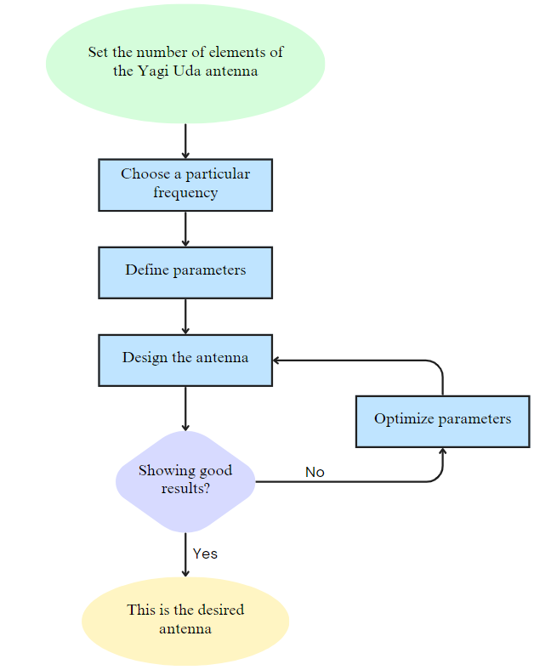
Flow Chart

Slide 13
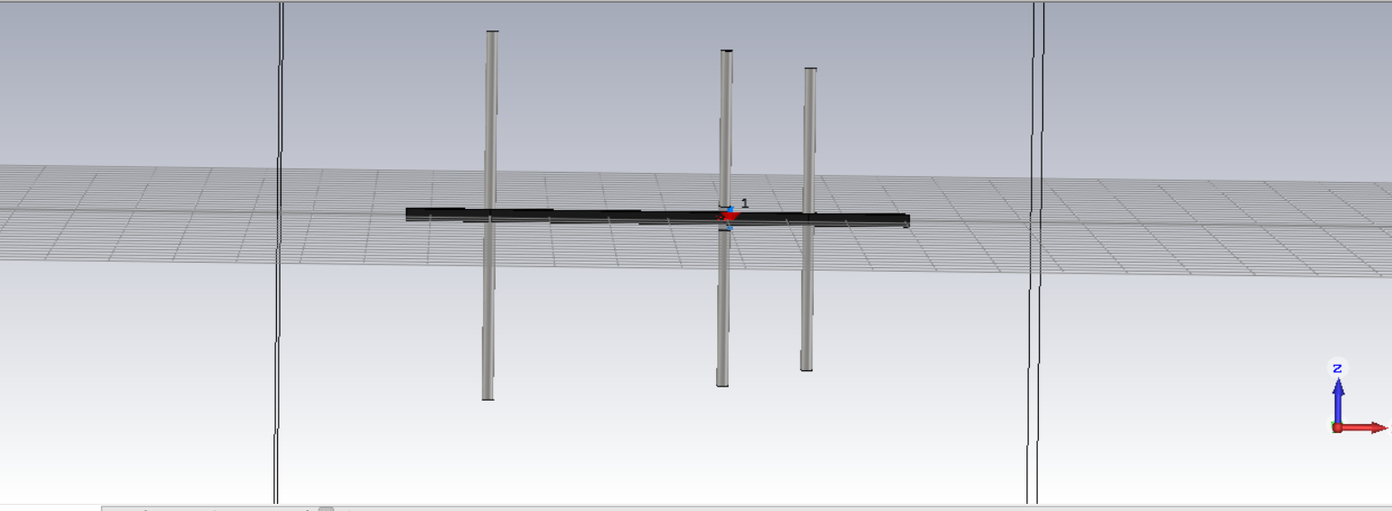
SIMULATION RESULTS
3 Element Yagi Uda Antenna
Fig: Diagram of three element Yagi-Uda Antenna

Slide 14
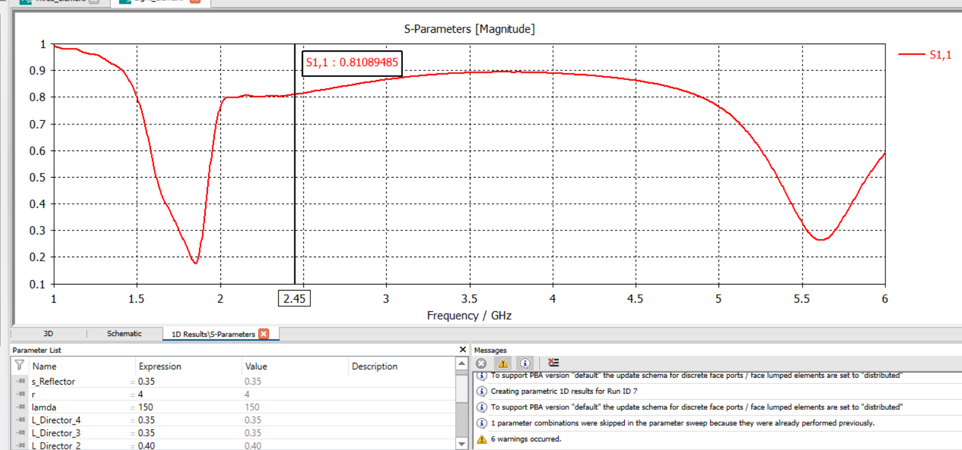
S parameter(Before Sweeping)
Fig: S parameter at lambda value of 150

Slide 15
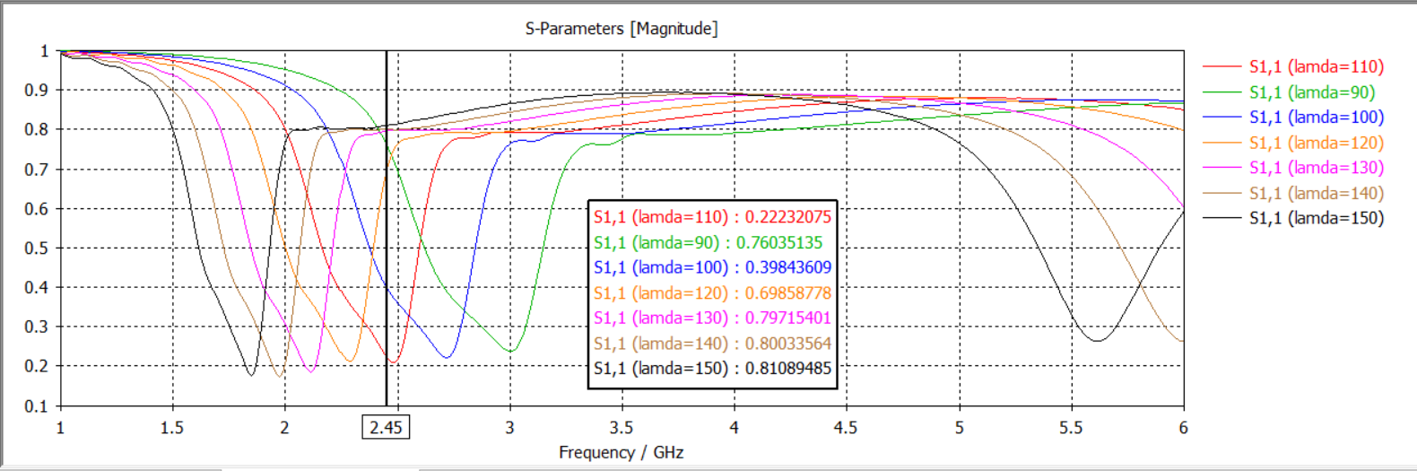
Parametric Sweeping

Slide 16
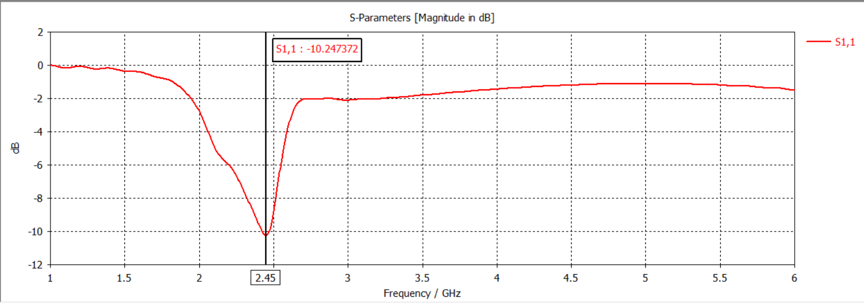
S parameter at 2.45 cutoff frequency

Slide 17
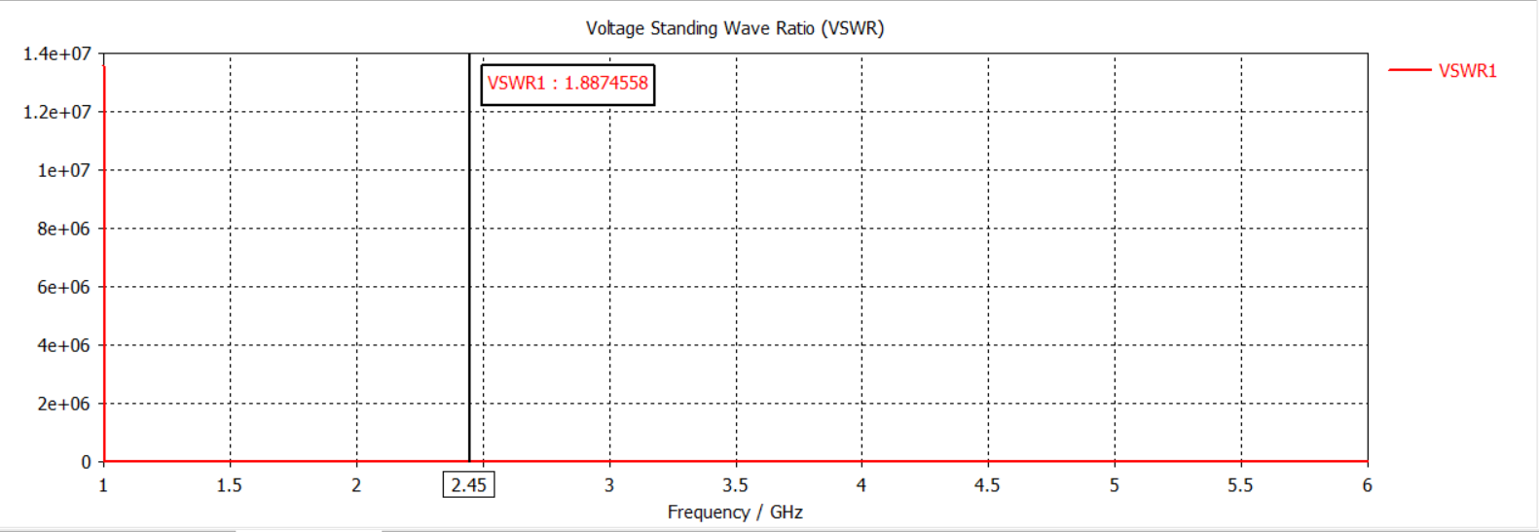
VSWR

Slide 18
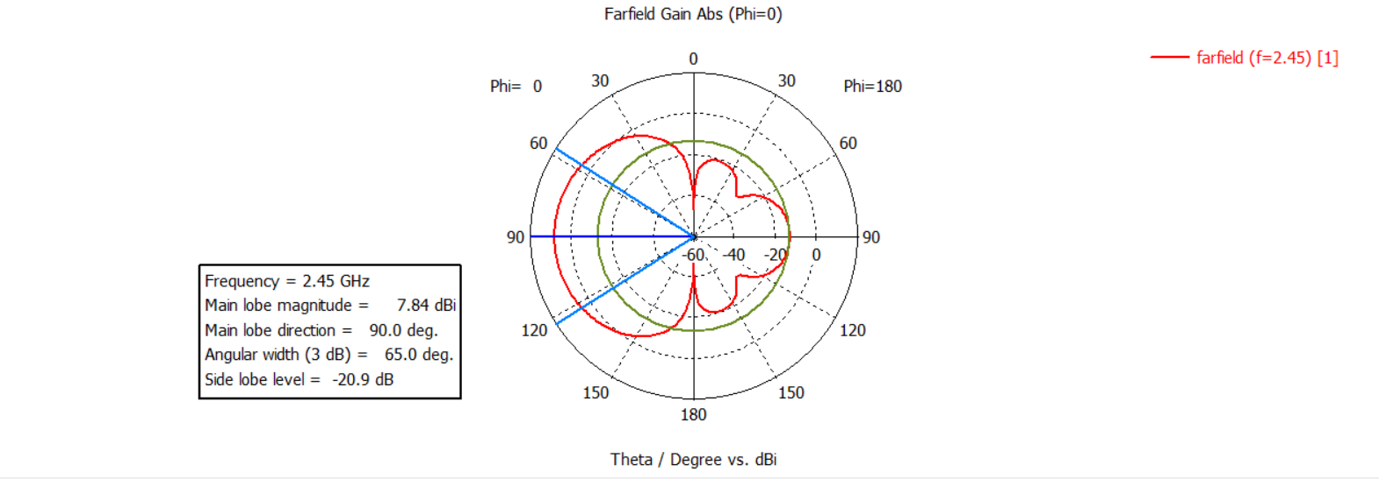
Far-field
The maximum far field gain achieved is 7.837 dB.
Fig: Far-field analysis

Slide 19
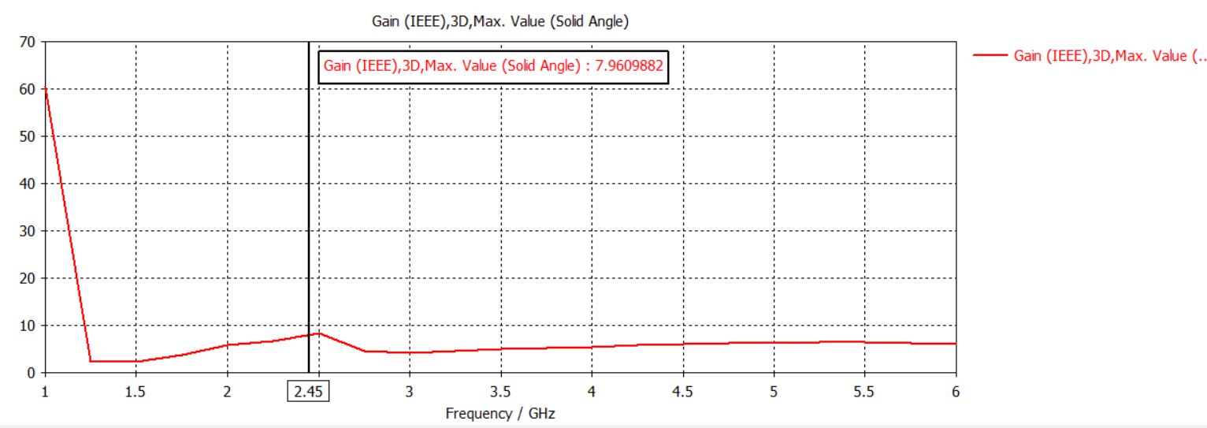
Gain vs Frequency
Fig: Gain vs Frequency curve

Slide 20
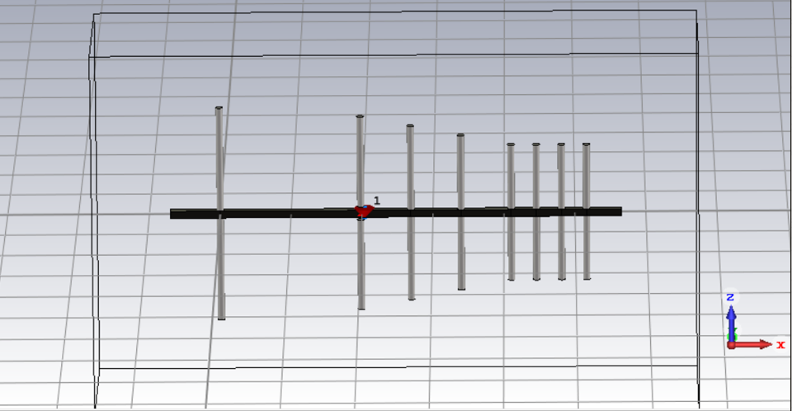
Eight element Yagi-Uda Antenna
Fig: Diagram of Eight element Yagi-Uda Antenna

Slide 21
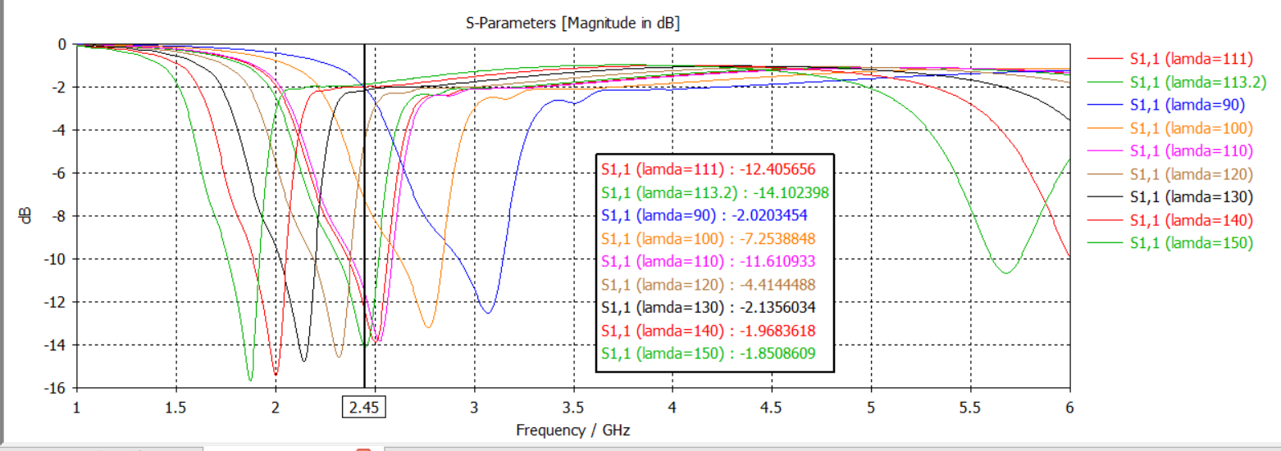
S parameter
Fig: Parametric sweeping for 8 elements

Slide 22
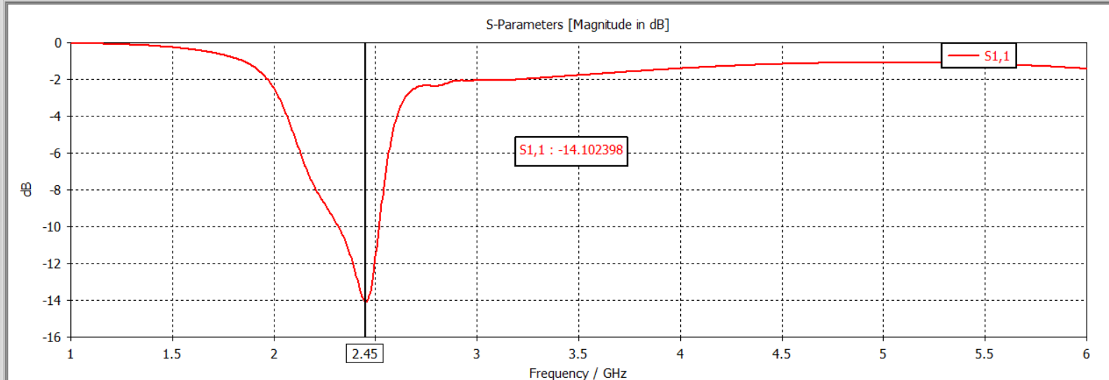
S parameter
Fig: S parameter at 2.45 GHz

Slide 23
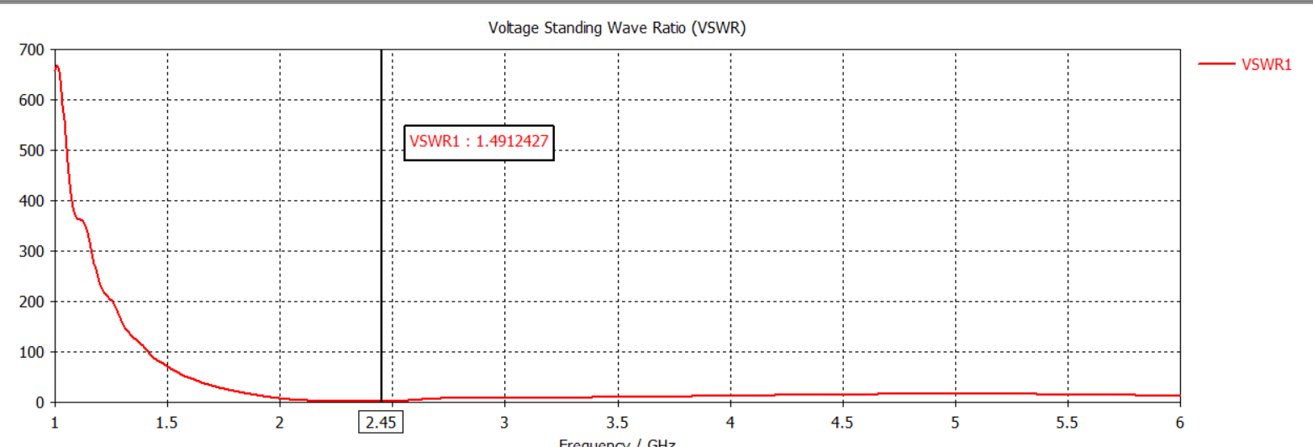
VSWR
Fig: VSWR at 2.45 GHz

Slide 24
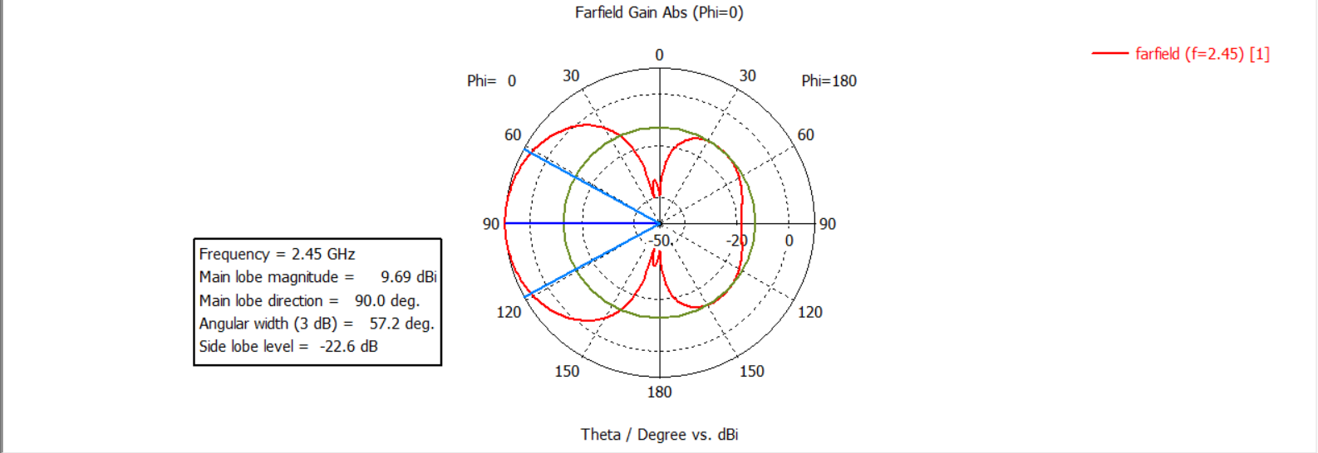
Far-Field
The maximum far field gain achieved is 9.693 dBi.
Fig: Far field analysis for 8 element Yagi-Uda Antenna6

Slide 25
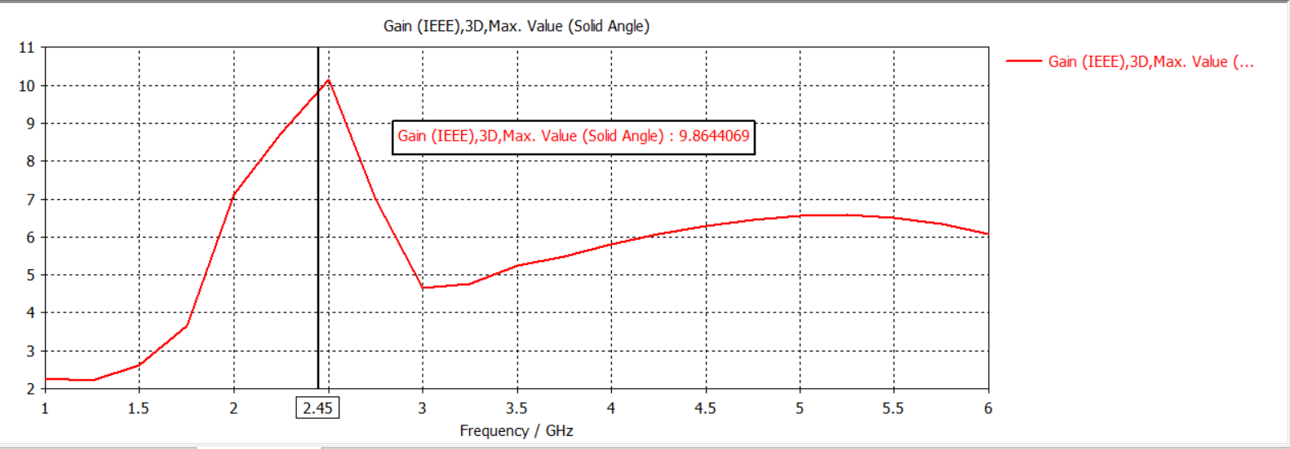
Gain vs Frequency
The gain is high at the desired frequency.
Fig: Gain vs Frequency curve

Slide 26
Interpretation of Results
Wavelength value is changed to obtain desired output.
Parametric sweeping is applied .
8 element antenna has higher far field gain.
By using Boom results slightly shifts from the desired frequency.

Slide 27
Application of the Design
The applications of the Yagi-Uda antenna are as follows:
Television reception in the VHF and UHF frequency ranges.
Amateur (ham) radio for long-distance communication.
Improve detection and tracking in radar systems.
Satellite communication for signal transmission and reception in ground stations
Wi-Fi signal enhancement in specific directions to improve coverage and reduce interference.

Slide 28
Shortcomings/ Drawbacks of the Design
The drawbacks of the design of Yagi-Uda antenna are as follows:
The antenna has a narrow bandwidth, means it operates over a limited frequency range.
To achieve high gain, the antenna requires a large size with a long boom and multiple elements, making it bulky and difficult to install.
The design can become complex when additional directors are added.
The antenna is prone to noise and environment.

Slide 29
Conclusion
The Yagi-Uda antenna is a highly effective design in wireless communication. Its simple structure, which includes a driven element and parasitic elements, allows for significant signal enhancement. This makes it a popular choice for applications like television reception, amateur radio, and radar systems. As technology continues to advance, there is great potential to improve the Yagi-Uda antenna's bandwidth and reduce its size for modern communication needs.

Slide 30
References
1] H. Yagi and S. Uda, “Projector of the Sharpest Beam of Electric Waves,” Proc. Imp. Acad., vol. 2, no. 2, pp. 49–52, 1926, doi: 10.2183/pjab1912.2.49.
[2] C. A. Balanis, Antenna theory: analysis and design, Fourth edition. Hoboken, New Jersey: Wiley, 2016.
[3] C. A. Balanis, Modern Antenna Handbook. Somerset: Wiley, 2011.
[4] A. Zeghdoud, M. C. Derbal, and M. Nedil, “Gain Optimization of a Yagi-Uda Antenna using the Genetic Algorithm,” in 2019 IEEE International Symposium on Antennas and Propagation and USNC-URSI Radio Science Meeting, Atlanta, GA, USA: IEEE, Jul. 2019, pp. 1041–1042. doi: 10.1109/APUSNCURSINRSM.2019.8889003.
[5] R. Reddy and R. Swaminathan, “Directivity Improvement of 9-Element Yagi Uda Antenna by increasing director elements in comparison with 7-Element Yagi Uda Antenna,” in 2022 3rd International Conference on Intelligent Engineering and Management (ICIEM), London, United Kingdom: IEEE, Apr. 2022, pp. 561–564. doi: 10.1109/ICIEM54221.2022.9853131.

Slide 31
[6] T. A. Nisamol, P. Abdulla., and K. K. Ansha, “Wideband Sub-THz Substrate lens Yagi- Uda antenna for 5G Communications and beyond,” in 2020 IEEE-HYDCON, Hyderabad, India: IEEE, Sep. 2020, pp. 1–5. doi: 10.1109/HYDCON48903.2020.9242679.
[7] A. Ali, H. Wang, and I. Park, “A Yagi-Uda Antenna Implemented with Solar Cells,” in 2024 IEEE International Workshop on Antenna Technology (iWAT), Sendai, Japan: IEEE, Apr. 2024, pp. 323–325. doi: 10.1109/iWAT57102.2024.10535854.
[8] R. K. Tanti, S. Warathe, and N. Anveshkumar, “Planar Yagi-Uda Antenna with Mirrored Ground Plane for WLAN,” in 2020 11th International Conference on Computing, Communication and Networking Technologies (ICCCNT), Kharagpur, India: IEEE, Jul. 2020, pp. 1–5. doi: 10.1109/ICCCNT49239.2020.9225278.
[9] D. Wang et al., “A Planar Quasi Yagi-Uda Antenna Designed For Liquid Crystal Based End-Fire Phased Arrays,” in 2021 IEEE Radio and Wireless Symposium (RWS), San Diego, CA, USA: IEEE, Jan. 2021, pp. 164–167. doi: 10.1109/RWS50353.2021.9360363.

Slide 32

THANK YOU

Slide 33
If any query

